Slide 1
Reporting of sales data from channel partners for Sales operation created with Brity RPA designer/orchestrator
Terry Lee

Slide 2
Disclaimer
This file does not contain any sensitive corporate data, specific process details, or information pertaining to any particular organization or individuals. Its purpose is to offer a high-level view of the generic steps taken by the authors to address a specific business problem. It serves as a scalable and adaptable template, enabling the replication of these steps for solving similar problems in future. Additionally, it includes technical details that can be partially or entirely reused for ongoing learning and improvement in future projects.

Slide 3
Business problem: I need to collate weekly sell out data from multiple distributors, combined them manually in excel, create pivot tables and cross check with our company sales portal data through manual pasting. Now, the size of the excel file grew more than 30MB and it started crashing every 5min upon pivot and update. I cannot continue on with this, is there a way to manage the data more efficiently while manipulating, cross referencing and pivoting are all gracefully performed?
Solution: Pivoting and comparing data from multiple sources in a single excel file can cause burden, not an ideal situation when the data size is expected to grow more at a rapid pace. The raw history data is better separated in a single file, to be pivoted to wide form (from long form) before merging into the tracker file in excel for dashboard and comparison with other data. The history data then can be transposed between wide and long form via Python (pivot/melt) taking advantage of keeping it in wide form. (1MB as opposed to 20MB for raw data) It can then be easily analysed from a variety of platforms (Python pandas/matplotlib/seaborn, Tableau, Power BI, ..) or can be ported to SQL DB. All manual processing of receiving files via email, extracting data from a worksheet in excel, combining into different excel file, add further data from elsewhere and updating dashboard can be executed in complete automation with accuracy and consistency on a daily/weekly scheduled run from the orchestrator of Robotic Process Automation.

Slide 4
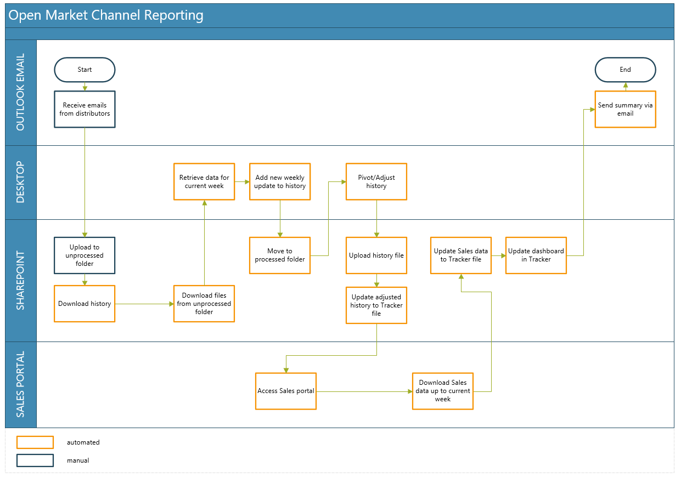
Under implementation

Slide 5
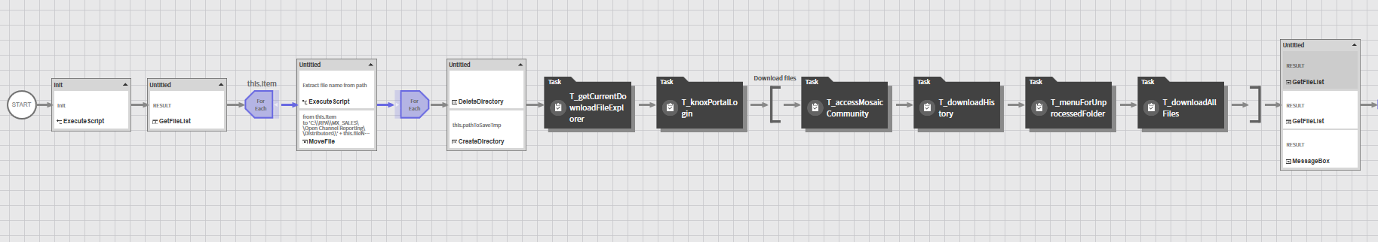
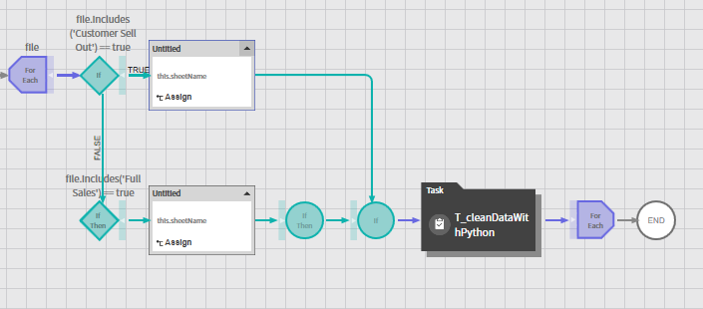
Process: DownloadWeeklyFromDistributors
Task to view [1]
Task to view [2]
Task to view [3]
Task to view [4]

Slide 6
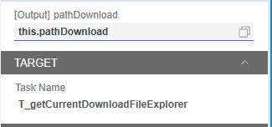
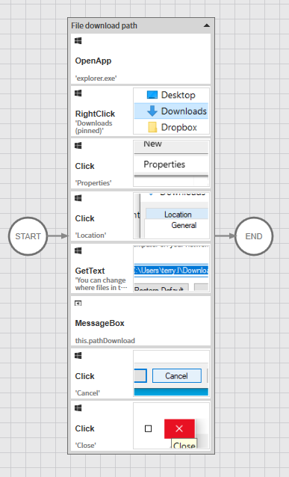
Task to view [1] – T_getCurrentDownloadFileExplorer

Slide 7
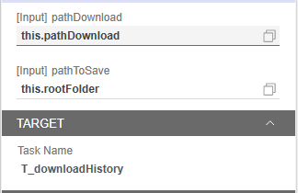
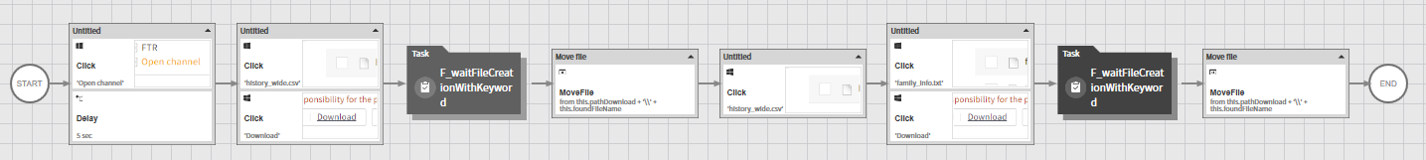
Task to view [2] – T_downloadHistory

Slide 8
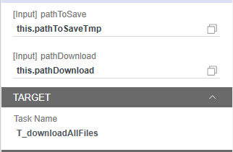
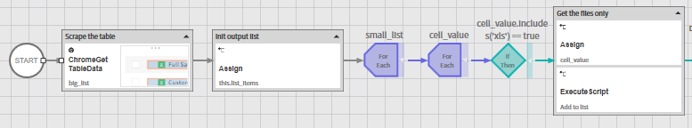
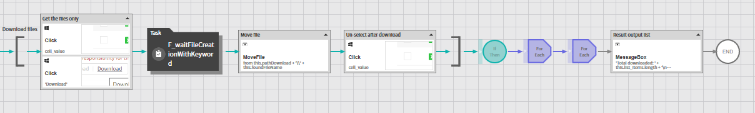
Task to view [3] – T_downloadAllFiles

Slide 9
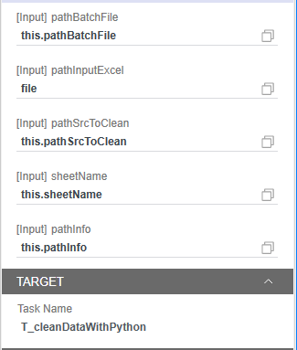
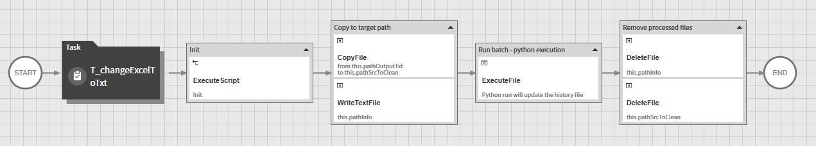
Task to view [4] – T_cleanDataWithPython
Code to view [1]

Slide 10
Code to view [1] – Python custom functions
import pandas as pd import datetime import sys def get_distributor_name(file_name): if ‘XX---- ---- -----' in file_name: return ‘X - -------' elif ‘YY - --- -----' in file_name: return ‘Y - -------' return '' def melt_and_clean(df_target, file_name): if 'Customer Sell Out' in file_name: df_target = df_target.drop([0]) df_target['Distributor'] = ‘X - -------' elif 'Full Sales' in file_name: df_target['Distributor'] = ‘Y - -------' cols = ['Distributor', ‘XXXX XX ', XXXX', ‘XX XX ', ‘XX XXX', ‘XXX ', ‘XXXXXX', ‘XXXXXX '] if ‘ZZZ ' in df_target.columns: del df_target[‘ZZZ '] df_l = df_target.melt(id_vars=cols, var_name='Date', value_name='Sales') df_l['Sales'] = df_l['Sales'].astype('str') df_l['Sales'] = df_l['Sales'].str.replace('`', '').str.replace(',', '') df_l['Sales'] = df_l['Sales'].apply(lambda x: x if x != '' else '0') df_l['Sales'] = df_l['Sales'].astype('float') df_l.fillna(0, inplace=True) return df_l def date_change(d): return d[:4] + d[5:7] + d[8:10]
""" param: date in yr-month-date (YYYY-MM-DD) return: date in yr-week no (YYYY-WK) """ def date_to_wkno(d): if is_col_name_date(d): yr = int(d[:4]) wk = datetime.date(int(d[:4]), int(d[5:7]), int(d[8:10])).isocalendar()[1] if int(d[5:7]) == 1 and wk >50 : yr -= 1 if wk<10: wk = '0' + str(wk) return str(yr) + '-W' + str(wk) return d def is_col_name_date(col_name): p = re.compile('.*\d{4}-\d{2}-\d{2}.*') res = p.findall(col_name) return len(res) > 0

Slide 11
Code to view [1] – Python code to transform data
# Read weekly update file_path = sys.argv[1] with open('C:\RPA\XXX\Open Channel Reporting\Script\info.txt', 'r') as f: file_name = f.read() print(file_name) print("reading source file into dataframe: " + file_path) df = pd.read_csv(file_path, header=0, sep='\t') df_l = melt_and_clean(df, file_name) df_l.to_csv('weekly_{}.csv'.format(get_distributor_name(file_name))) # Read history df_all = pd.read_csv(r'C:\RPA\XXX\Open Channel Reporting\history_wide.csv') df_all_l = melt_and_clean(df_all, '') # Add weekly update to history df_all_l = pd.concat([df_all_l, df_l]) # Pivot the updated history and then save pvt = df_all_l.pivot_table(index=['Distributor', ‘XXXX XX', XXXX', ‘XX XX', ‘XX XXX', ‘XXX', ‘XXXXXX', ‘XXXXXX'], values='Sales', columns=['Date'], aggfunc='sum') pvt.reset_index(inplace=True) pvt.index.name = None pvt.columns.name = None pvt.to_csv(r'C:\RPA\XXX\Open Channel Reporting\history_wide.csv', index=False) pvt.to_csv(r'C:\RPA\XXX\Open Channel Reporting\history_wide_{}.csv'.format(datetime.datetime.today().strftime('%Y-%m-%d')), index=False)

